Slide 1
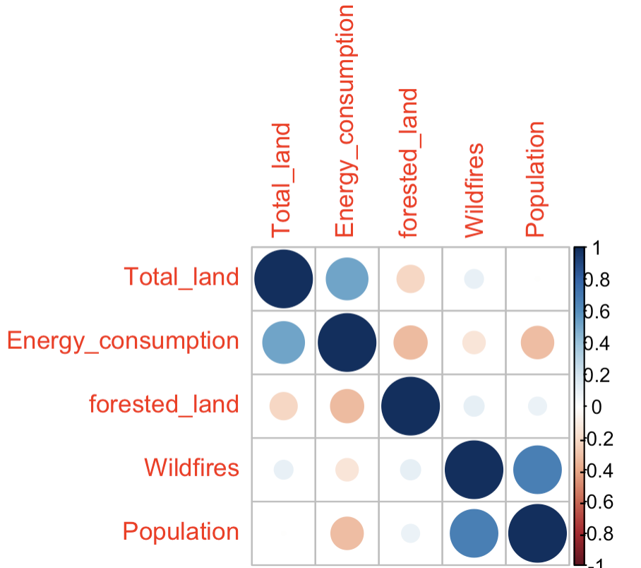
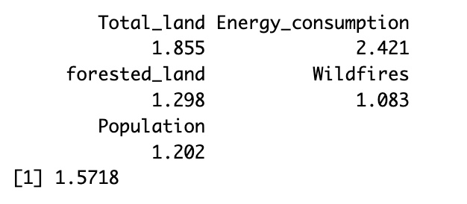
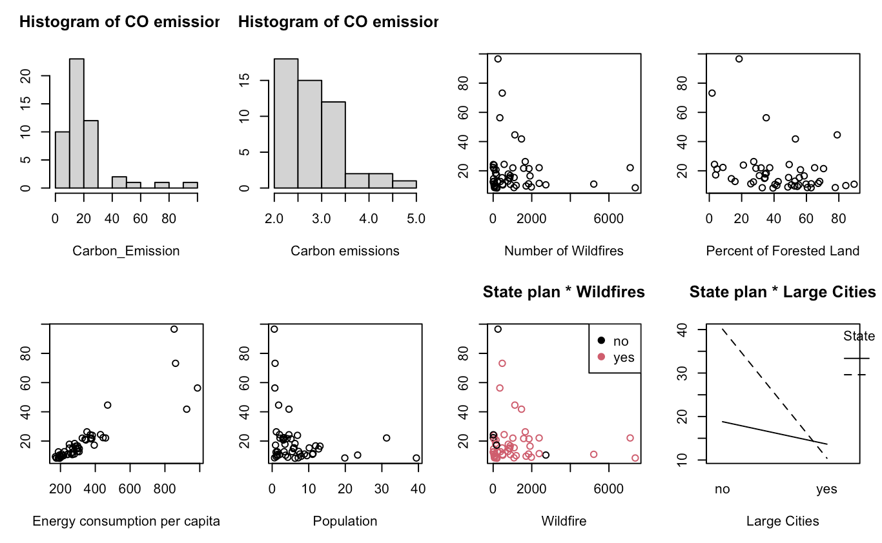
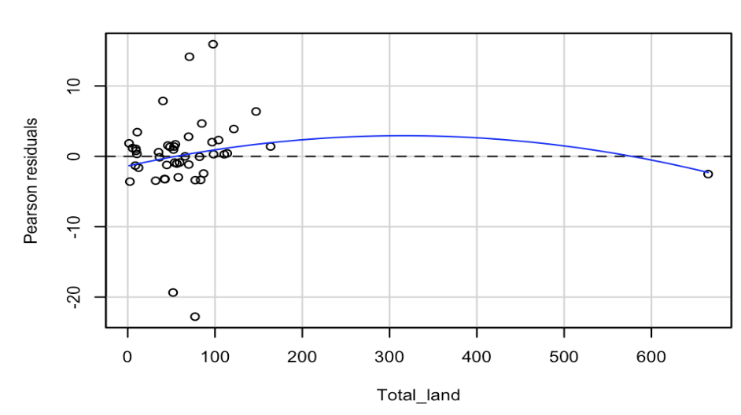
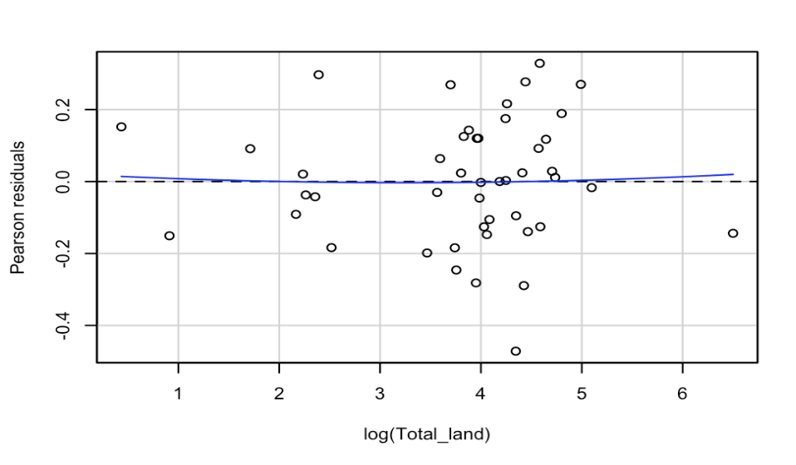
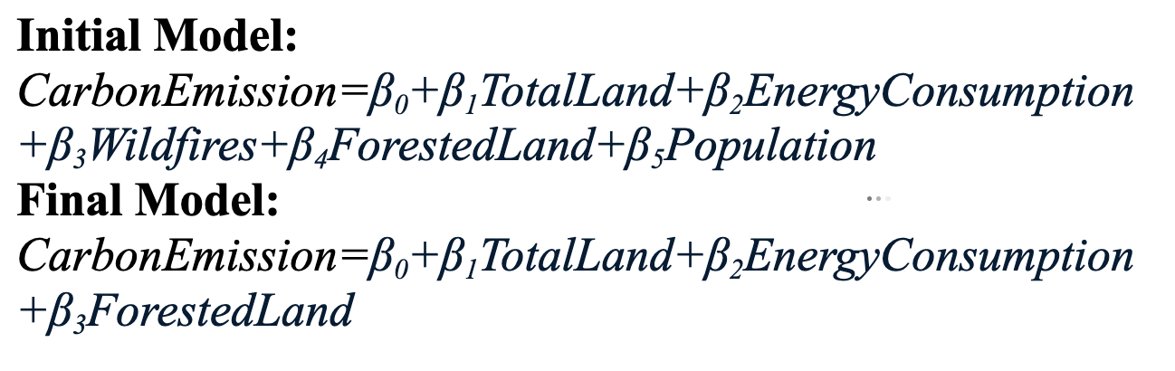
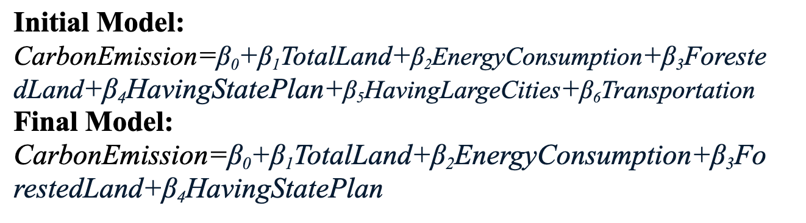
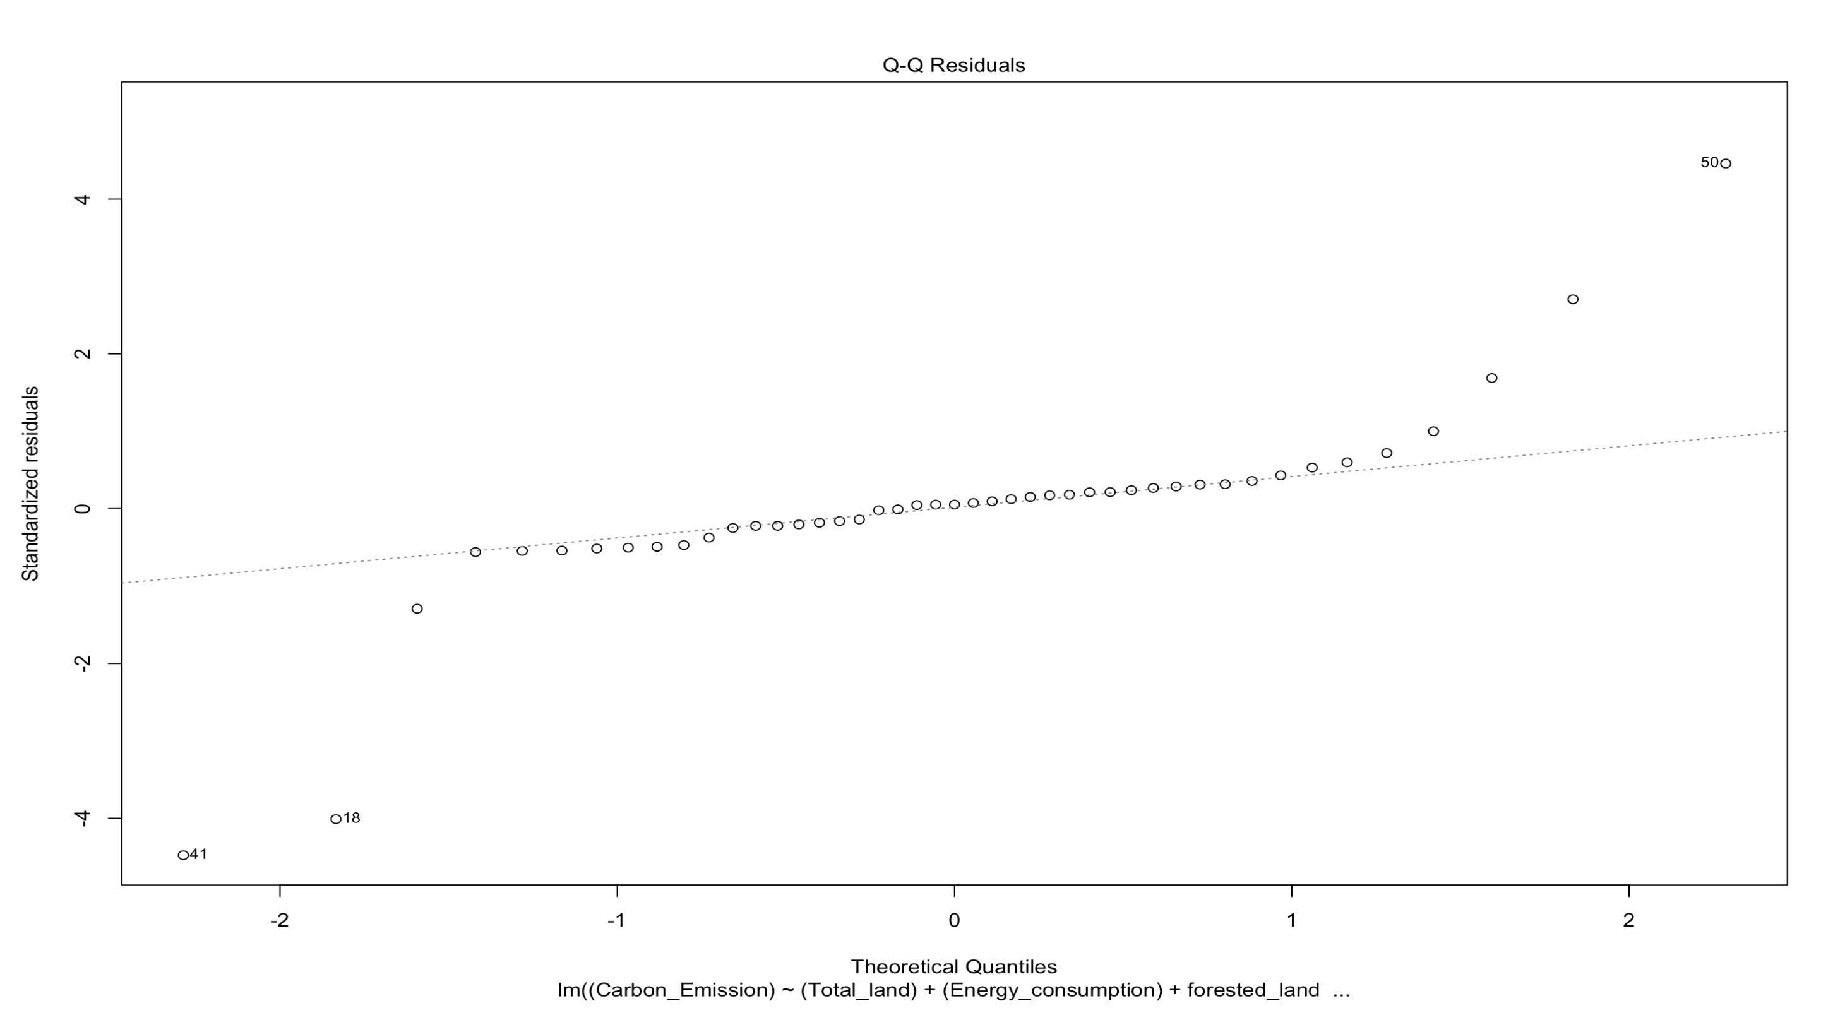
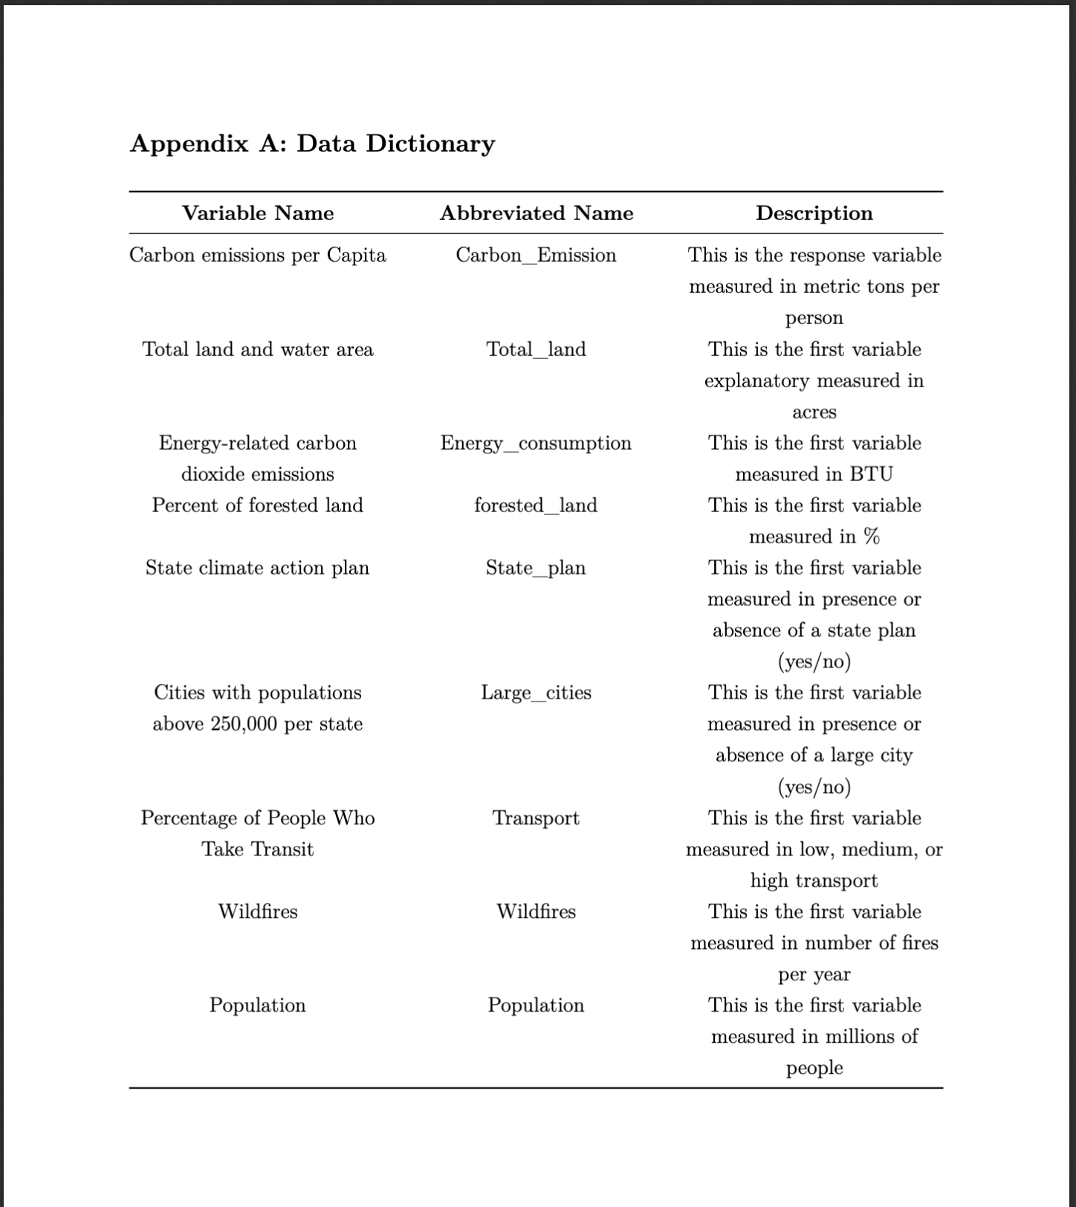
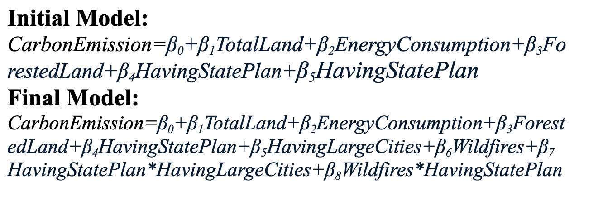
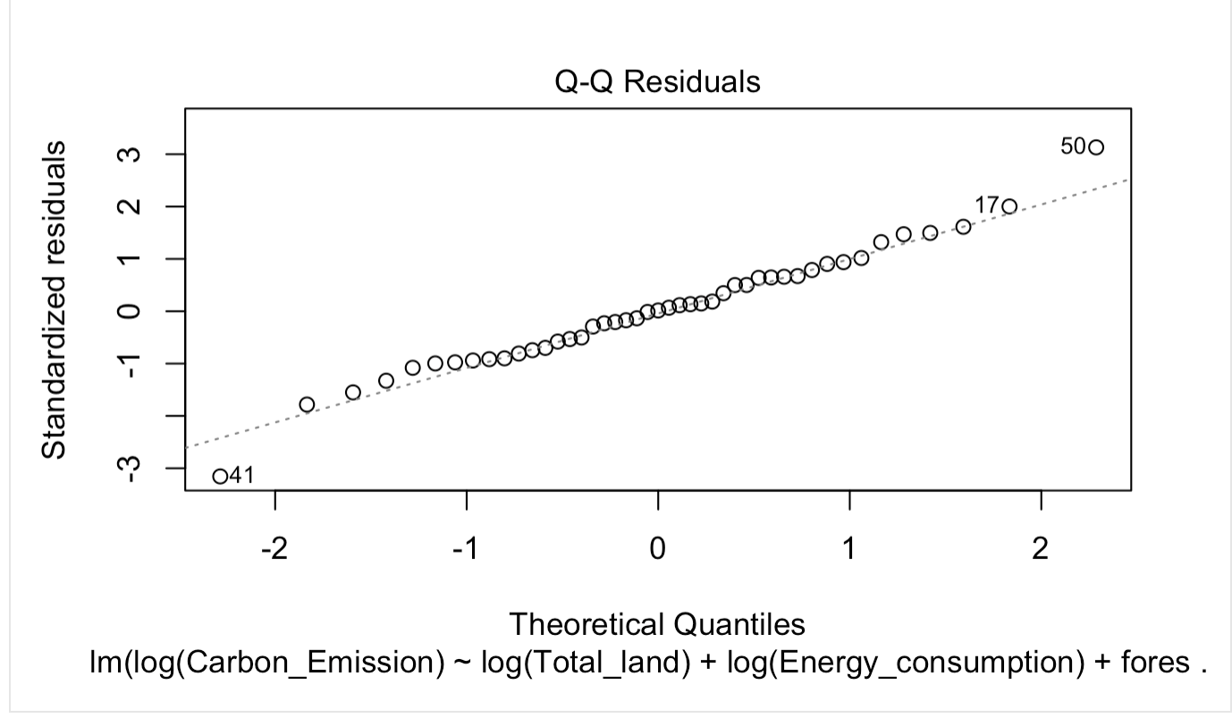
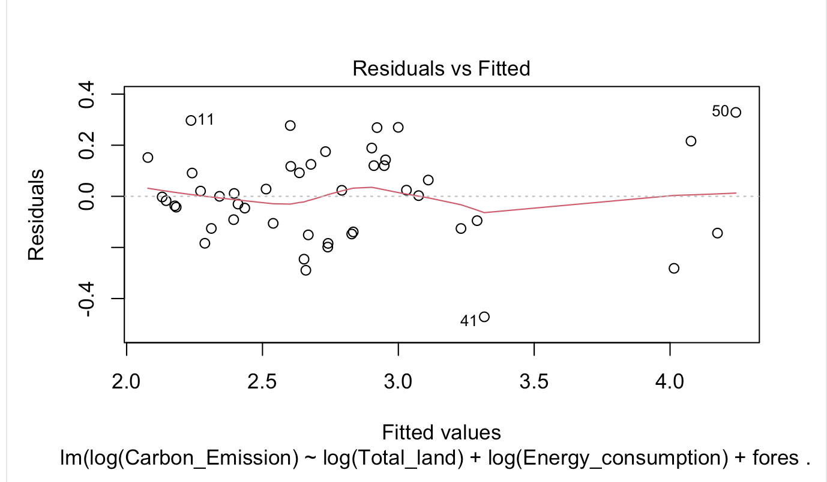
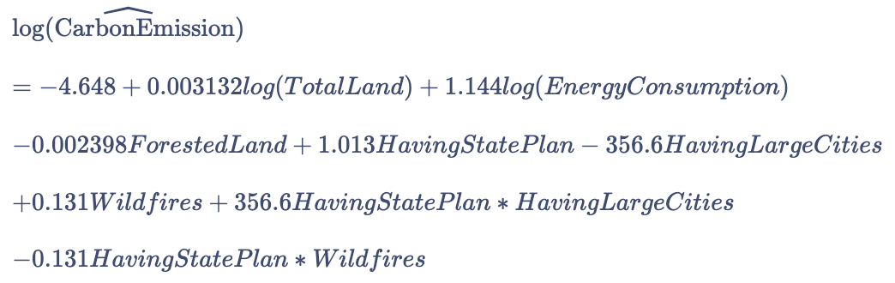
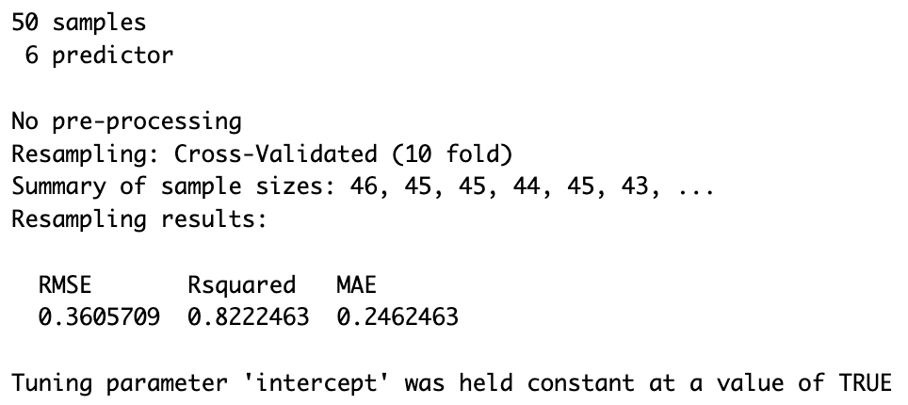
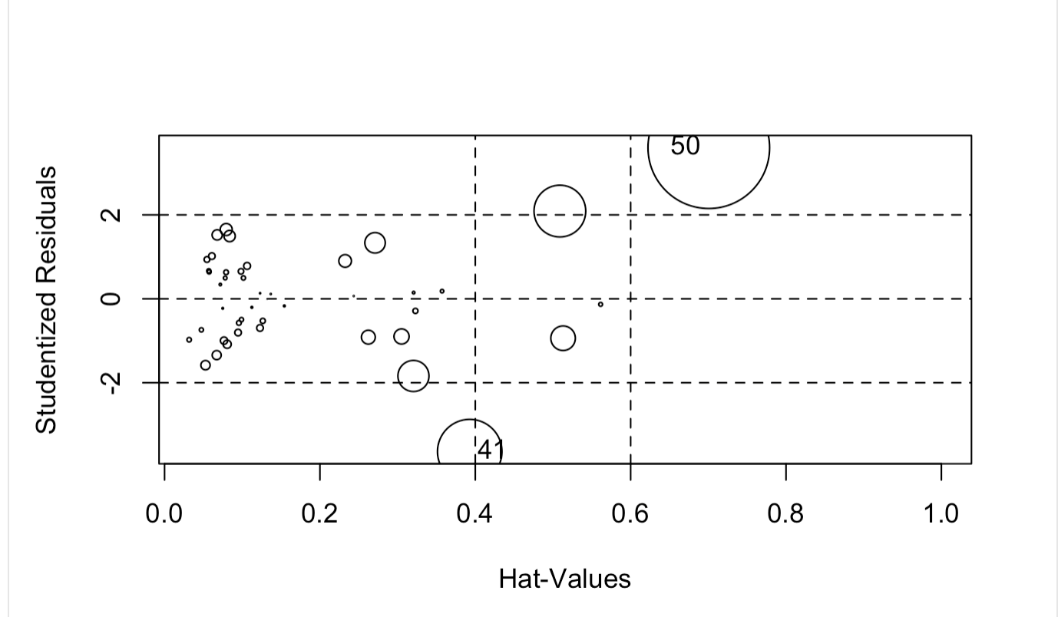
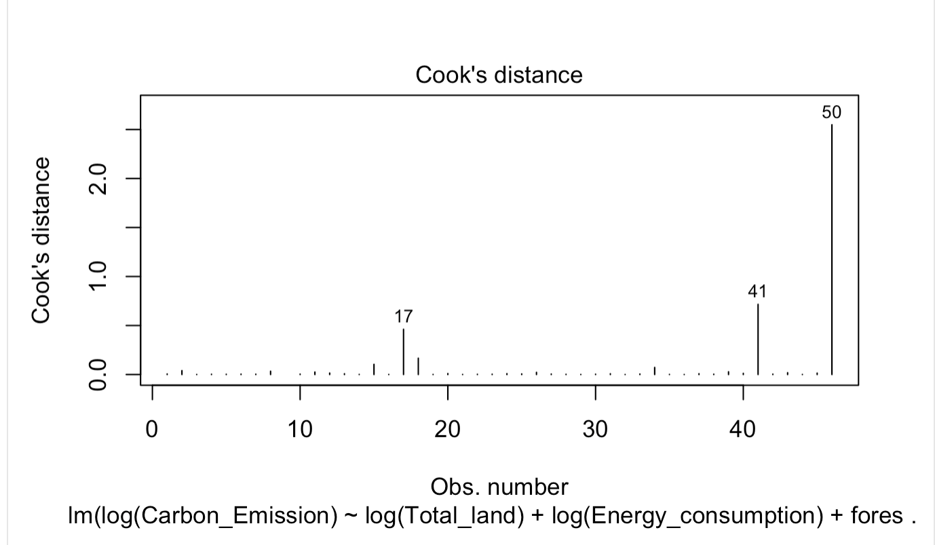

Factors Affecting Carbon Dioxide Emissions per Capita (metric tons/person) In the United States
By: Hershi, Jianlin, Rhea
Introduction
Research Questions
Checking for Multicollinearity
Conclusion and Further Research
This project analyzes factors influencing CO2 emissions per capita (metric tons/person) across U.S. states.
It's relevant due to the growing climate crisis and its impact on health as worsening air pollution can cause risks like heart and lung diseases (EPA, 2025)
The goal is to identify high-emission areas and understand contributing factors to target where action is needed and what potential policies or efforts need to be most urgently implemented
If carbon emissions keep rising then the earth's environment and ecosystem might not be able to function well (Climate Global Footprint, 2024)
Do states with more wildfires throughout the year relate to an increase in the average carbon dioxide emissions per capita measured in metric tons per person?
Does the intervention of state governments in the USA positively affect the environment by decreasing the average carbon dioxide emissions per capita?
Does a state using high amounts of public transportation lead to lower or decreasing levels of carbon dioxide emissions per capita?
With a p-value smaller than 0.05 based on the global F test, we can reject the null hypothesis. The model is adequate at predicting carbon dioxide emissions
Our exploratory data analysis revealed important relationships between wildfires, transit, state policies, and carbon emissions. CO2 emissions were initially skewed, so we applied a log transformation.
Our prediction equation predicted the value 20.77 and the carbon emission of the actual state was 21.5. (Alabama values: 0 for large cities, 1 for state plan, 1,856 wildfires, 52.42 total land, and 375 energy consumption; multiply these values by each slopes to compute)
Larger land/water areas were significantly associated with lower emissions (β = 0.012, p = 0.001). States with climate action plans had higher emissions (β = -3.163), though the result wasn’t statistically significant (p = 0.097). Transit use patterns also showed mixed, non-significant trends.
For future research, we should try new variables such as considering air quality index or look at chemical properties of climate change, such as increasing ozone factors which also harm the environment (EPA, 2025)
We can also add other countries and their states as observations to see how other countries stand on the climate crisis
VIF Values
- The vifs are smaller than 10 and the mean vif is less than 3
-There was no reason for variable screening, no severe multicollinearity
sd
Checking MLR Assumptions
Pairwise correlation plot
EDA and Data Dictionary
Model Building
EDA and Data Dictionary
Step 1: Adding Quantitative variables
Step 2: Adding Qualitative variables
transformation
With our model, the assumptions for normality were violated, so we transformed the model. The transformed model is shown below.
Step 3: Adding Interactions
References
New Assumptions
League of American Bicyclists. States: Rates of Active Commuting. data.bikeleague.org, https://data.bikeleague.org/data/states-rates-of-active-commuting/. Accessed 23 Apr. 2025.
World Population Review. Most Forested States 2024. https://worldpopulationreview.com/state-rankings/most-forested-states. Accessed 23 Apr. 2025.
Agency for Healthcare Research and Quality. Medical Expenditure Panel Survey: County and State Codes. https://meps.ahrq.gov/survey_comp/county_state.shtml. Accessed 23 Apr. 2025.
StatsAmerica. State Population Rankings. https://www.statsamerica.org/sip/rank_list.aspx?rank_label=pop1. Accessed 23 Apr. 2025.
U.S. Census Bureau. State Population Totals and Components of Change: 2020-2023. https://www.census.gov/data/tables/time-series/demo/popest/2020s-state-total.html. Accessed 23 Apr. 2025.
Statista. Lowest Elevation Points in the U.S. by State 2023. https://www-statista-com.proxy1.library.virginia.edu/statistics/1325529/lowest-points-united-states-state/. Accessed 23 Apr. 2025.
Insurance Information Institute. Facts + Statistics: Wildfires. https://www.iii.org/fact-statistic/facts-statistics-wildfires. Accessed 23 Apr. 2025.
Statista. Land Are a of the United States by State. https://www-statista-com.proxy1.library.virginia.edu/statistics/203923/united-states-land-area-by-state/. Accessed 23 Apr. 2025.
U.S. Environmental Protection Agency. 45 States, Large Metro Areas Submit Climate Action Plans under President Biden’s Climate Challenge. https://www.epa.gov/newsreleases/45-states-large-metro-areas-submit-climate-action-plans-under-president-bidens. Accessed 23 Apr. 2025.
U.S. Energy Information Administration. State Energy Data System (SEDS): Data Files. https://www.eia.gov/state/data.php. Accessed 23 Apr. 2025.
https://www.footprintnetwork.org/our-work/climate-change/. Accessed 23 Apr. 2025.
Health. EPA, https://www.epa.gov/climateimpacts/climate-change-impacts-health. Accessed 23 Apr. 2025
Step 4: After Transformation
Prediction Equation
w
RMSE=0.361
On average, this model’s predictions are off by about 0.36 log-units of CO₂ emissions
R-square=0.822
model explains ~82.2% of the variation in unseen data
MAE=0.246
The average absolute error in log-units is about 0.25
Outliers:
We removed observation 50 and 41(Wyoming and South Dakota)
Cross Validation
Outliers 50 and 41 were removed
Adjusted R square=0.8705
P-value<2.2*10^-16
Considering our Dummy variables for the final model:
where Large_Cities= 1 if yes, 0 otherwise
Where State_plan= 1 if yes, 0 otherwise

